Slide 1

SWD 392 - Software Architecture and Design

Slide 2
SWD392
Object Structuring

Slide 3
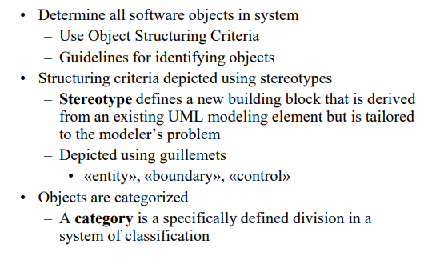
Object Structuring Criteria

Slide 4
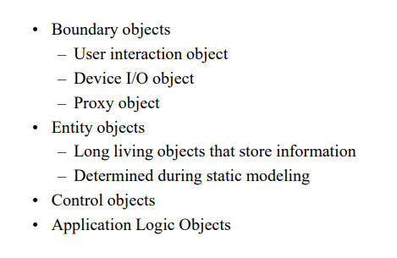
Object Structuring Criteria

Slide 5
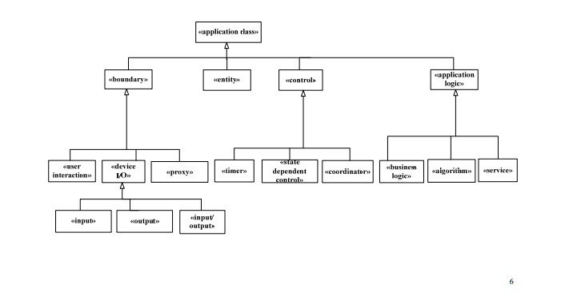
Object Structuring Criteria

Slide 6
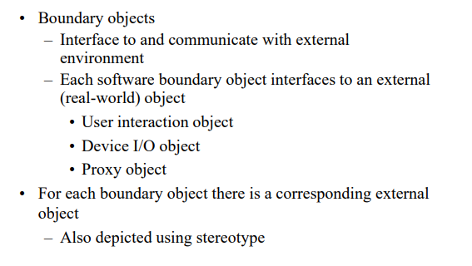
Object Structuring Criteria

Slide 7
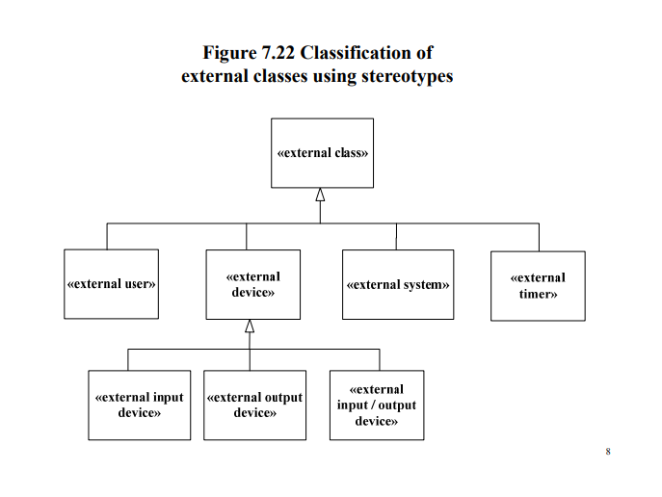
Object Structuring Criteria

Slide 8
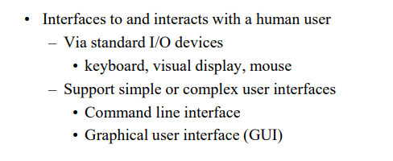
User interaction object

Slide 9
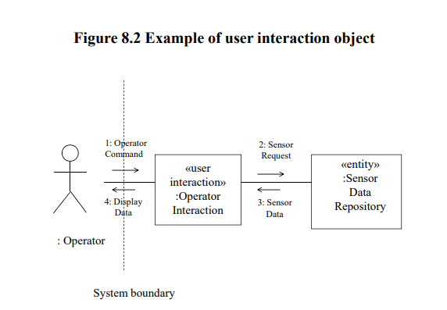
User interaction object

Slide 10
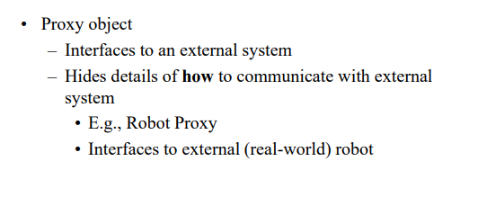
Object Structuring Criteria

Slide 11
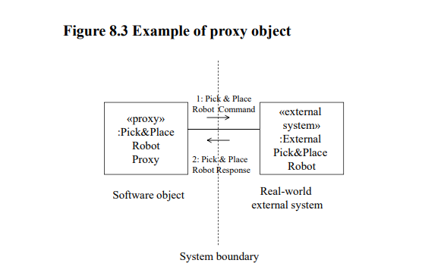
Object Structuring Criteria

Slide 12
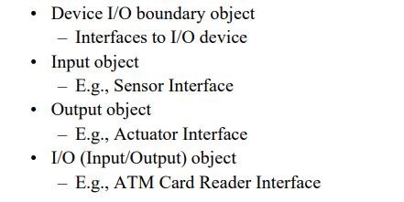
Object Structuring Criteria

Slide 13
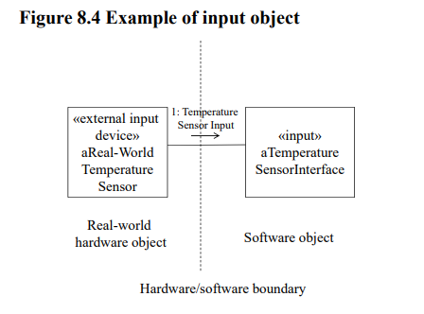
Object Structuring Criteria

Slide 14
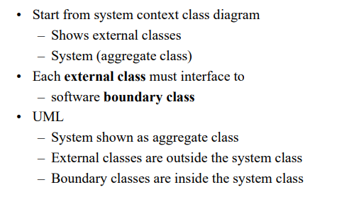
Depicting External Classes and Boundary Classes

Slide 15
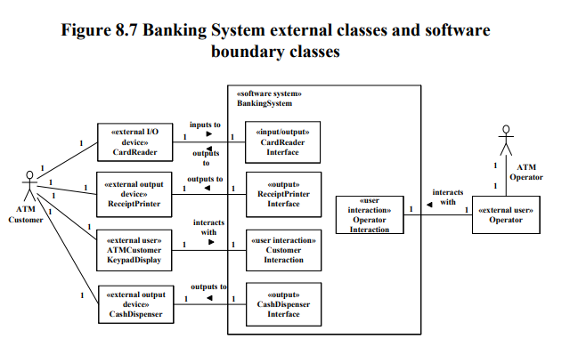
Depicting External Classes and Boundary Classes

Slide 16
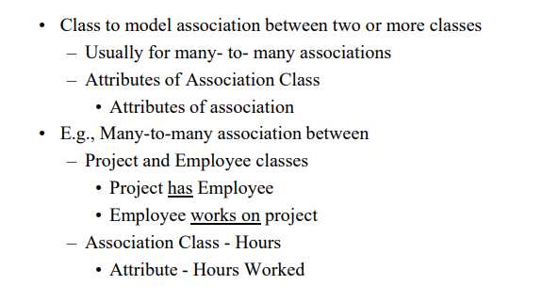
Association Class

Slide 17
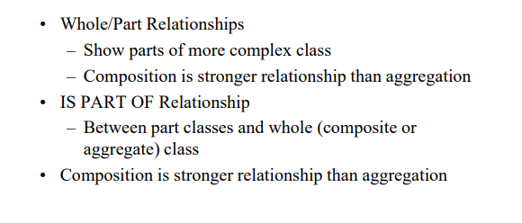
Composition/Aggregation Hierarchy

Slide 18
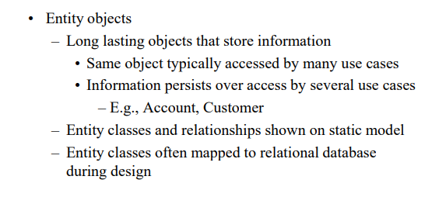
Object Structuring Criteria

Slide 19
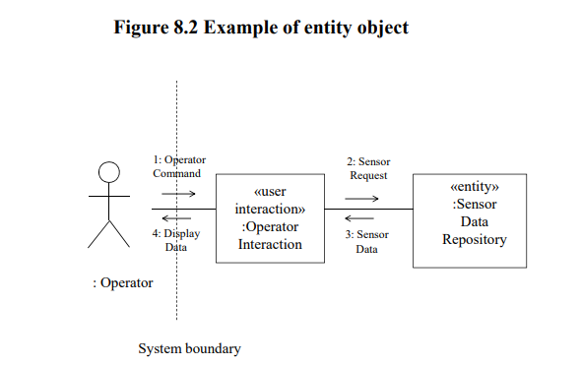
Object Structuring Criteria

Slide 20
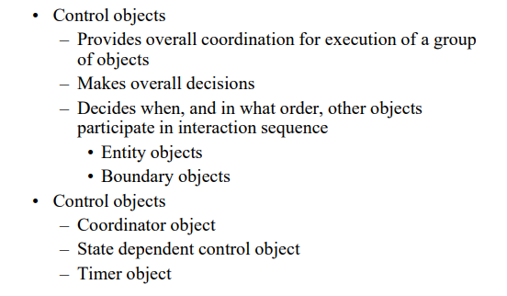
Object Structuring Criteria

Slide 21
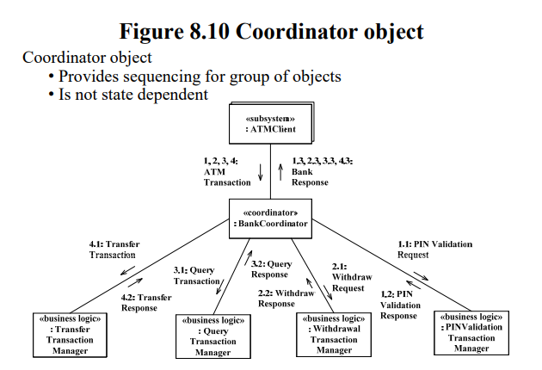
Object Structuring Criteria

Slide 22
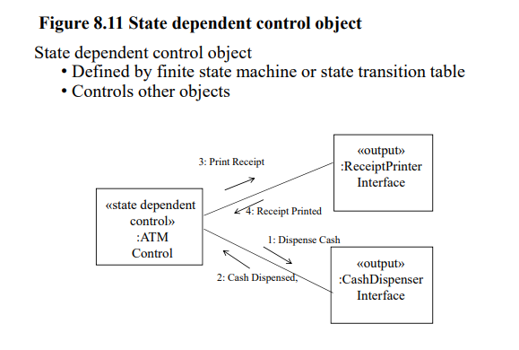
Object Structuring Criteria

Slide 23
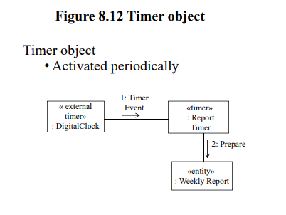
Object Structuring Criteria

Slide 24
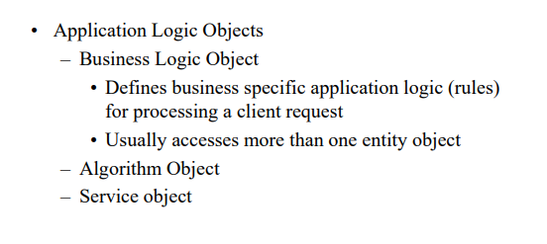
Object Structuring Criteria

Slide 25
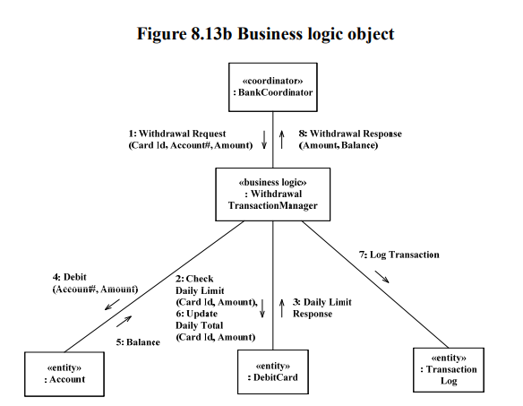
Object Structuring Criteria

Slide 26
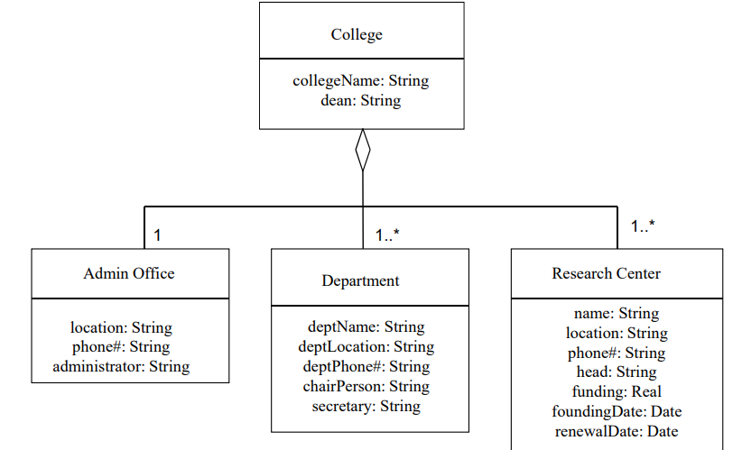
Object Structuring Criteria

Slide 27
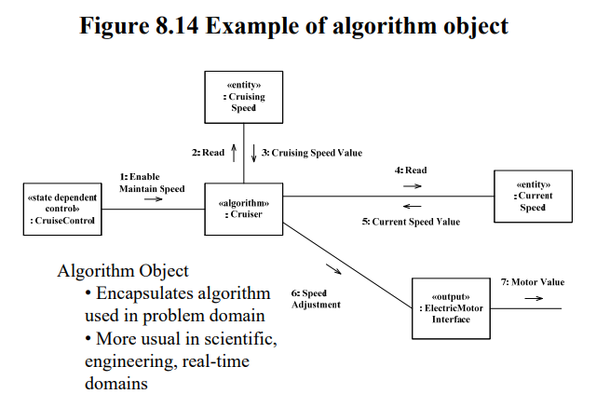
Object Structuring Criteria

Slide 28
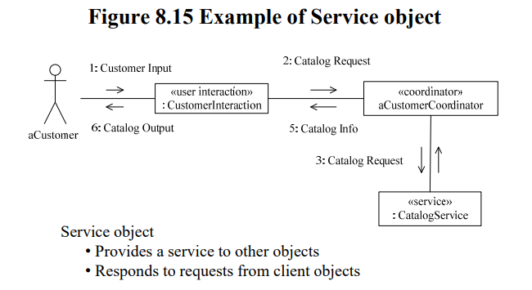
Object Structuring Criteria

Slide 29
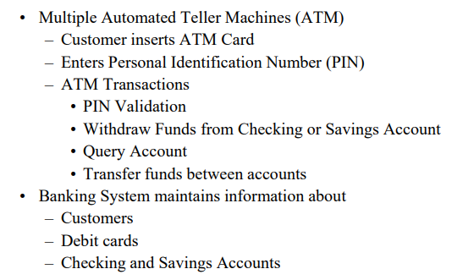
Case Study: Banking System

Slide 30
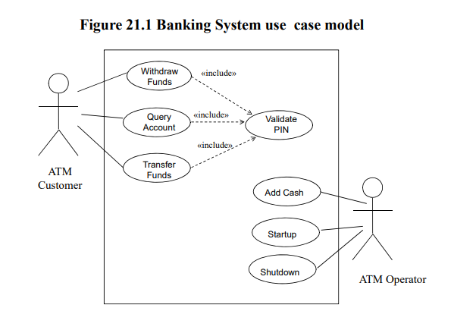
Case Study: Banking System

Slide 31
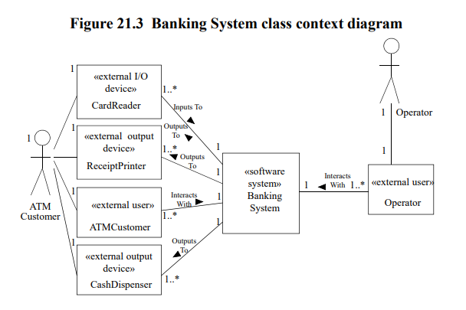
Case Study: Banking System

Slide 32
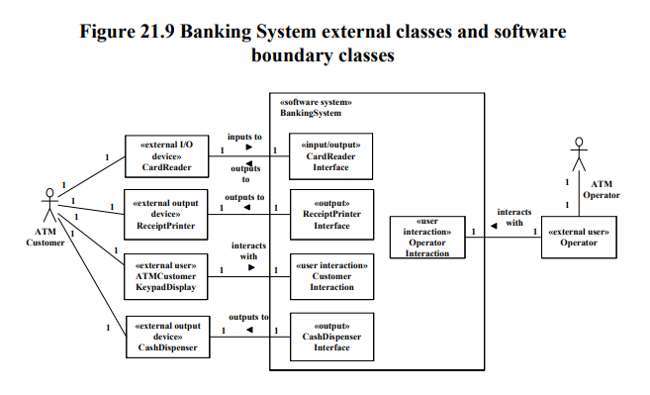
Case Study: Banking System

Slide 33
Thanks!
Does anyone have any questions?
CREDITS: This presentation template was created by Slidesgo, including icons by Flaticon, infographics & images by Freepik
Please keep this slide for attribution

